Slide 1
Read Write Inc
Parents’ Information session
jude.durnan@ea.edin.sch.uk
Literacy Development Teacher
Literacy and Dyslexia Support Team
Additional Support for Learning Service

Slide 2

Where are you starting from?
How confident do you feel about supporting your child with RWI at home?

Slide 3
Aims
    To have an understanding of:
    The Literacy Interventions used in CEC
    Phonics
        How to say pure sounds
        Assisted and independent blending
        Spelling and writing strategies
        Resources and strategies for parents

Slide 4
Aim:
To have an understanding of the Literacy Interventions used in CEC

Slide 5
Literacy Support in CEC
P1 – P2
Literacy Rich
Literacy and Dyslexia Support Team
P3 - P5
Read Write Inc
Sir Sean Connery Foundation Dyslexia Initiative
P6 – P7
Fresh Start
Group Literacy Programme
S1 – S2+
SRA
Notes:
How do we support those who are not reading in lower Primary? Robust system of literacy support in place in CEC.
Start with Literacy Rich Edinburgh in P1+2
A phonics programme for Primary 1 and 2.
Used in Edinburgh schools for many years with great success.
Systematic and progressive programme, so the learning is cumulative with each step revisited for the purposes of reinforcement.
Some children with literacy difficulties, at the end of P2 they will not have acquired all the phonic knowledge needed to decode and blend sounds to read words and so further intervention will be required.
Dyslexia/Processing/working memory/phonological awareness/SALT/ASD/ASHD + other things attendance, trauma, FASD etc
So what do we do?
Edinburgh has a robust system of literacy support in place using well researched programmes.
This is the context in which you are working
JD
This is the big picture: some will be very familiar, some new to this –
PATHWAY 1
Literacy Rich - lots of good strategies in use in classrooms to develop literacy. For children who have had input in P1 and P2 with Literacy Rich and who are not able to recognise sounds/blend they would be identified by P1/P2 class teacher and SfL as requiring further intervention.
PATHWAY 2
If pupil is identified as needing further support, these are the interventions we use at different stages:
Read Write Inc: P3, P4 & P5 as appropriate
Fresh Start: P5 – P7
SRA phonics (Fast Track): S1 and S2
Need to consider that if a pupil has had RWI and FS in Primary how effective will SRA be?
If at any stage the intervention is not working, we need to look deeper into individual needs using the DLA:
Could be an entire 1:1 programme
Could be a small group programme
Could identify one area of need e.g., spelling and that is supported
PATHWAY 3
If school does not have staff trained to use the DLA a referral to LDST would be made (now working by school instead of by individual pupil with the Sean Connery Funding).
Also, at Pathway 3:
ELPOL (Early Literacy Programme for Older Learners: P6 upwards) for bilingual learners
This programme supports children and young people from P6 onwards who are learning through English as an Additional Language and who have not previously acquired literacy or who have early literacy skills in their first language due to limited or interrupted prior education (e.g. pupils from mobile communities - Roma, Scottish Travellers, refugee and asylum seeker children/young people).
NB: the programme is not appropriate for learners who have had continuous education (in English and/or their first language) and are experiencing literacy difficulties.

Slide 6
Ruth Miskin’s Read Write Inc
Reading programme based on a firm understanding of phonics
Children are taught to blend and segment words
Texts used are all decodable at child’s level
Sound methodology – fast pace, interactive, highly structured, full participation is required – partner work
Nearly all schools currently use RWI/FS or both
Notes:
SUPPORTS PHONICS – provides thorough teaching to identify and support gaps
5 P’s in RWI
Pace
Participation – key to get them to do it eventually on their own
Praise – lots of encouragement because they are finding this hard
Purpose
Passion – PSAs need to instil sense of enjoyment! (not easy!)
Children only read book/module when they will achieve success – RWI = reading books, Fresh Start = modules

Slide 7
Aim:
To have an understanding of phonics

Slide 8
Phonics
A highly effective way of teaching reading and spelling. Based on the link between sounds (phonemes) and the way we write them down (graphemes)
Phoneme
The smallest unit of sound we hear in a word
Grapheme
one letter or a group of letters used to write one sound

Slide 9
Phonics
The phoneme is the sound and grapheme is the way that sound is written.
Each word contains the same number of sounds and graphemes, though a grapheme can be made of more than 1 letter.
i-n contains 2 phonemes & 2 graphemes
c-a-t “ 3 phonemes & 3 graphemes
ch-a-t “ 3 phonemes & 3 graphemes
l-igh-t “ 3 phonemes & 3 graphemes
c-r-a-sh “ 4 phonemes & 4 graphemes
s-t-r-ee-t “ 5 phonemes & 5 graphemes
*m-a-k-e “ 3 phonemes & 3 graphemes
Notes:
JD
Review of phonic terminology – phoneme is the sound and grapheme is the way that sound is written
Each word contains the same number of sounds and graphemes
Graphemes can have 1 2 3 or 4 letters
TWO LETTERS ONE SOUND – children need to understand this – often referred to as special/best friends
WEBINAR QUESTION: Let’s have an example – how many phonemes/graphemes are in the word ‘bright’?
Put your answer in the chat but don’t click return until I say – 3 2 1 SHOW ME!

Slide 10
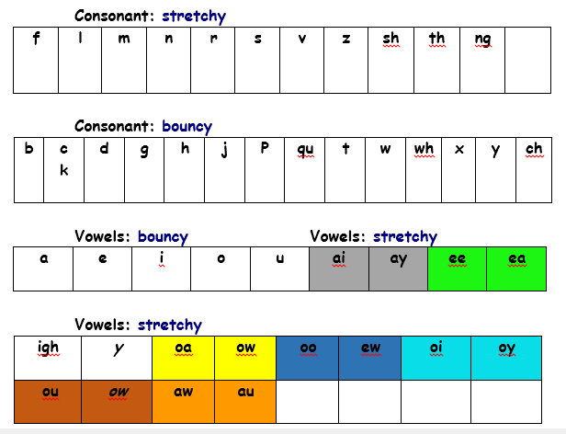
Simple Speed Sounds Chart
Notes:
Initial sounds – pure sounds

Slide 11
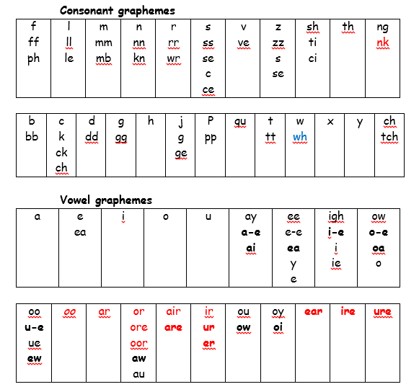
Complex Speed Sound Chart
Speed Sounds
Set 3
I Love Lucy YouTube OUGH
Notes:
Same sound, different way of writing
Same phoneme, different grapheme

Slide 12
Order of teaching Set 1 2 3 sounds
Set 1
m a s d t
i n p g o
c k u b
f e l h sh r
j v y w
th z ch qu x ng nk
Set 2
ay ee igh ow oo oo ar or air ir ou oy
Set 3
ea oi a-e i-e o-e u-e aw are ur er ow ai oa ew ire ear ure tion tious/cious

Slide 13

How to teach children to read and write initial sounds
Set 1
m a s d t
i n p g o
c k u b
f e l h sh r
j v y w
th z ch qu x ng nk
Say sound without card MTYT
Use picture/objects – m-m-m mouse
Draw simple picture version – run finger
Show how the letter comes out from the picture
Flip card m/mountain
Review with other sounds “there you are”
Use Maisie-Mountain-Mountain to write letter

Slide 14
Aims
How to say pure sounds

Slide 15
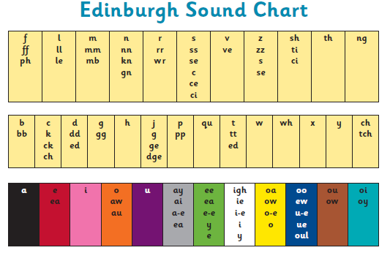
Edinburgh Sound Chart
Notes:
PURE SOUNDS – PowerPoint parents can use at home
Need to know consonants and vowels
Eventually need to know letter names as well for words that cant be spelled with phonics

Slide 16
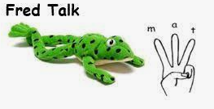
Aims
Assisted and Independent blending

Slide 17
Assisted Blending
The adult models everything first.
Once pupils have learned 5 sounds, they can use these sounds to blend to read.
Speed + accuracy = automaticity
Special Friends?
Fred Talk
Read the word
m a t
. . .
sh i p
_
. .
Notes:
JD TC model a couple of examples
Have some green words ready to use

Slide 18
Independent Blending
Once pupils have learned to read the words with support the aim is for them to blend sounds on their own:
Speed + accuracy = automaticity
Special Friends?
Fred Talk
Read the word
Special Friends?
Fred in your head
Read the word
Read the word
Notes:
JD TC model a couple of examples
Have some green words to do at speed

Slide 19
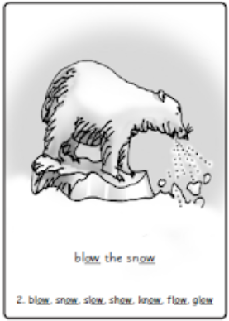

Set 2 Sounds
Set 2
ay ee igh ow oo oo ar or air ir ou oy
ow - blow the snow
Like Set 1, but there is a phrase and accompanying picture – 2 letters 1 sound.
Notes:
Set 2 sounds - like Set 1 but there is the mnemonic phrase and accompanying picture
Set 3 sounds - same sound. Looks different! ow/oa Same sound. Different spelling!
Recap – so far we have looked at:
the Literacy Interventions – RWI and Fresh Start
Hotlisting and its purpose
How to introduce, review and teach Set 1 sounds
Demonstrate SET 1 using large m/o/b cards – looking for automaticity – o orange m mountain b boot – at speed then speed write saying the sound
Explain how the cards work to support learning the sound / repetition / writing the letter for that sound
_____
The children are supported to remember/ LEARN the pure sounds using letter cards with mnemonics F f f ffffflower
M m m mmmmmountain. FLIP THE CARD PICURE SIDE PHRASE/LETTER SIDE SOUND
Simple picture prompt on one side
Letter or group of letters that represent the sound on others side
Set 2 sound cards different from Set 1 sounds as there is a PICTURE PHRASE on card to help children remember sounds
How to write the letter is on the card.
Tricky as two letters one sound – need to learn automatically.
HOTLIST – you may be asked to help learn the sound or form the letter
MTYTmmm
Draw Maisie mountain mountain, air write, show card and letter side.
Remind pupils to say and write

Slide 20
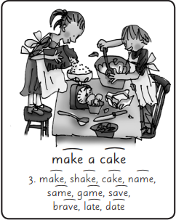



Set 3 Sounds
Set 3
ea oi a-e i-e o-e u-e aw are ur er ow ai oa ew ire ear ure tion tious/cious
a-e – make a cake
Like Set 2, same sound, looks different! ay/ai Same sound. Different spelling!
Notes:
Set 2 – learn AY
Set 3 – learn A – E then AI
Set 3 sounds - same sound. Looks different! ow/oa Same sound. Different spelling!

Slide 21
Aims
Spelling and Writing Strategies

Slide 22
EYES for Reading FINGERS for Spelling Using sound fingers
Ensure children:
know how to hold up their fingers and look at them before starting to spell
use their non-dominant hand for fingers
use their writing hand to point/ pinch fingers
point/ pinch in the correct direction
Remember two letters one sound/split grapheme
Children can trace letters onto fingers optional)
Children then sound and write the word
Notes:
JD READ SLIDE
Put hand in front of face.
Pinch from left to right
E.g. chat

Slide 23
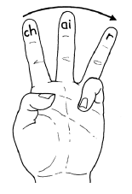
Sound Fingers
i-n contains 2 phonemes & 2 graphemes
c-a-t “ 3 phonemes & 3 graphemes
ch-a-t “ 3 phonemes & 3 graphemes
l-igh-t “ 3 phonemes & 3 graphemes
c-r-a-sh “ 4 phonemes & 4 graphemes
s-t-r-ee-t “ 5 phonemes & 5 graphemes
*m-a-k-e “ 3 phonemes & 3 graphemes
Finger Write
Notes:
MODEL CHAT LIGHT MAKE

Slide 24
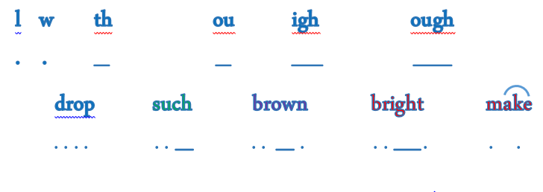
Grapheme Marking
Count the graphemes in the words
Draw a dot under each 1 letter grapheme
Draw a line under each 2 or 3 letter grapheme
Draw an arc to join split graphemes (a-e i-e o-e u-e)
Notes:
Done to reinforce number letter that make up sounds when we write them. (2 letters/ 1 sound)
When children have spelled the word get them to WRITE IT DOWN AND THEN GRAPHEME MARK IT

Slide 25
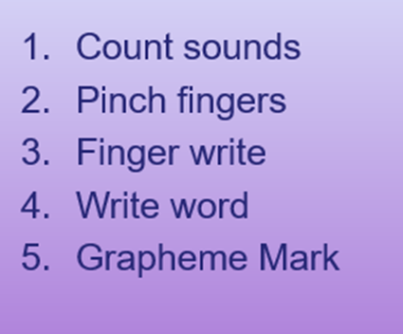
Sound Fingers & Grapheme Marking
Spell each word using Sound Fingers
Don’t forget to use PURE SOUNDS
brain
stamp
cake

Slide 26
Support for Writing - Hold a sentence
MTYT whole sentence until pupil remembers (different voices)
Punctuation mimes
Discuss tricky words or words with new sounds
Remind them to use sound fingers, chart and read over
Model writing of sentence if needed (hide)
Self-Mark - Write sentence word for word – child can correct with “fancy” pen
Notes:
Explain how it works
JUDE to MODEL with Toni/group
The rain is in my hair.
Make up own with sh word and the is

Slide 27

Red Words
Tricky bit?
Read the word
put
Speed + accuracy = automaticity
the
LDST - we use letter names to spell
said
Notes:
JD TC model a couple of examples
NEED TO KNOW LETTER NAME
Have some RED words ready to use

Slide 28
Red Words
Common words that contain tricky spelling (grapheme)
making them harder to read using phonic knowledge
Point out known phonics and the tricky letters.
Word within word e.g., here
Memory link / emphasise sounds – necessary
Games/activities:
Post its stuck round room. Give to parents
Personalise it – drawing the word
Wordsearches, box dictation – size and shape
ICT – Wordsharks, iPad apps, Education City etc
worksheetgenius.com
Notes:
RED CARD
Mnemonics

Slide 29
Aims
Resources and strategies for parents

Slide 30
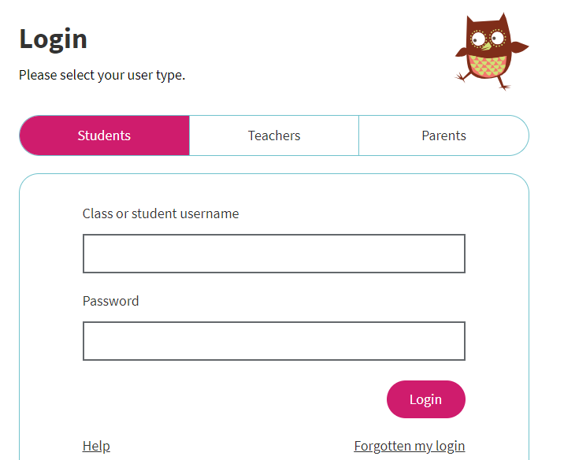
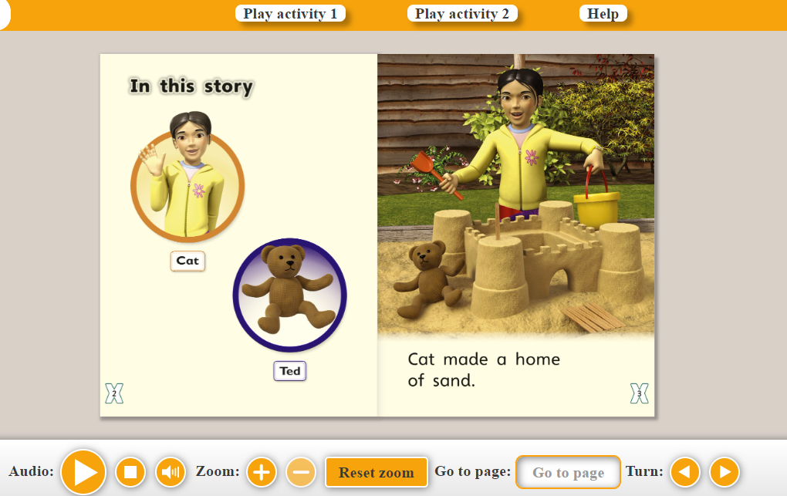
Oxford Owl

Slide 31

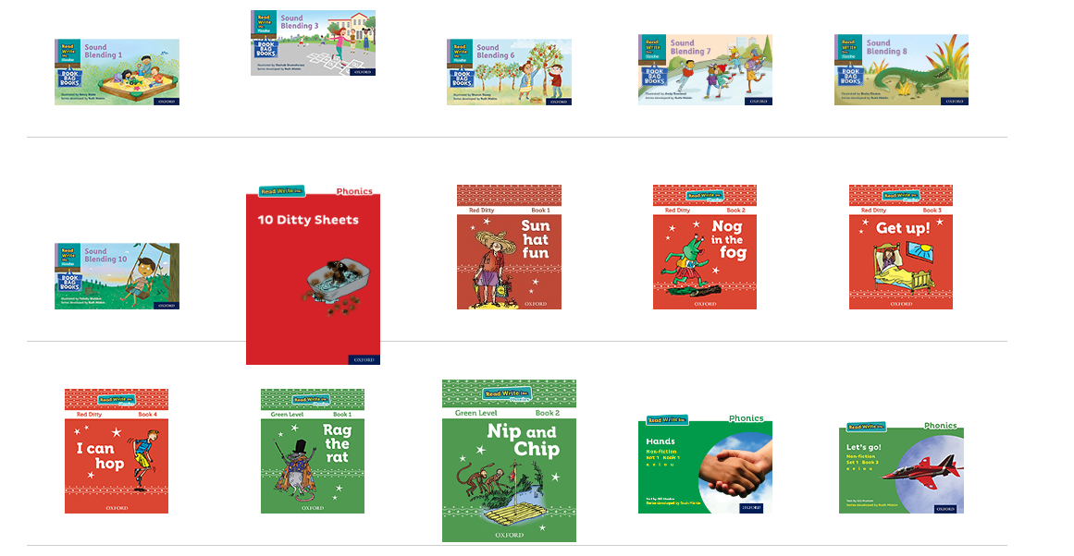
Oxford Owl

Slide 32

Ruth Miskin Website
Parents - Ruth Miskin Literacy

Slide 33
Summary of supports
Review pure sounds
Assisted blending – Fred Talk
Independent Blending – Fred in your Head
Finger Spelling – count the sounds
Red words – what’s the tricky bit?
Dictate a sentence
Let children read and reread to you
Read to them
Don’t overload with literacy homework - strengths

Slide 34

Making it fun
Swat the sound with fly swatter
Throw bean bag at sound
Have “rainbow of sounds” on wall – child to run under sound
Throw the beach ball - catch side has sound on it
ICT e.g., make dice on iPad, Hairy Letters
Find the sound – hidden in room / puzzle / whiteboard
Game – SWAP, Connect 4, blockbusters
Flash card games – e.g., pairs

Slide 35
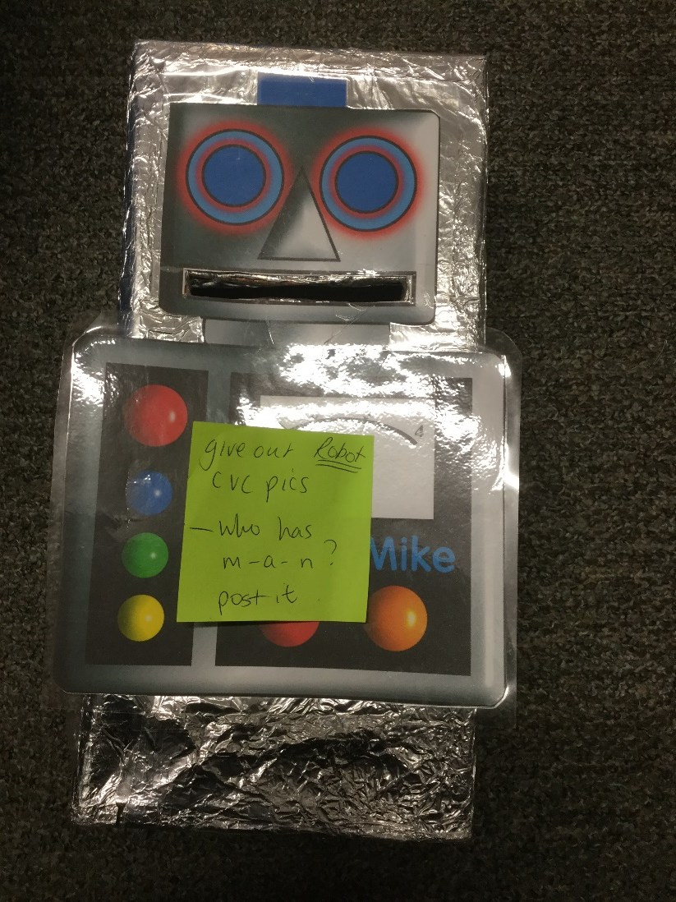
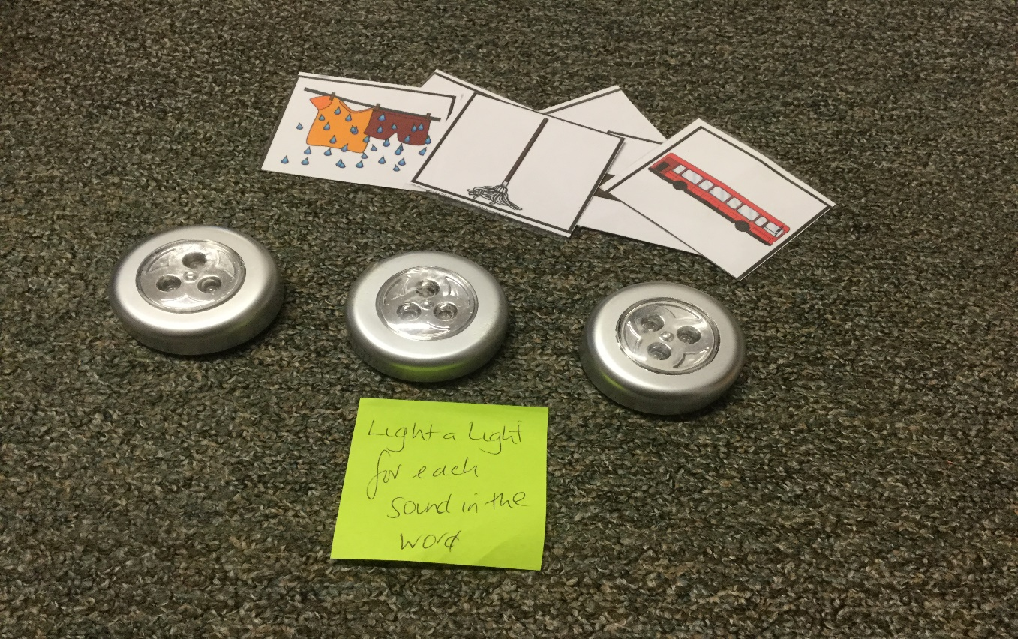
Making it fun
Notes:
JD
Robot speak – say sounds then word, feed into robot
Light for each sound – look at picture, say sounds/word + press light

Slide 36
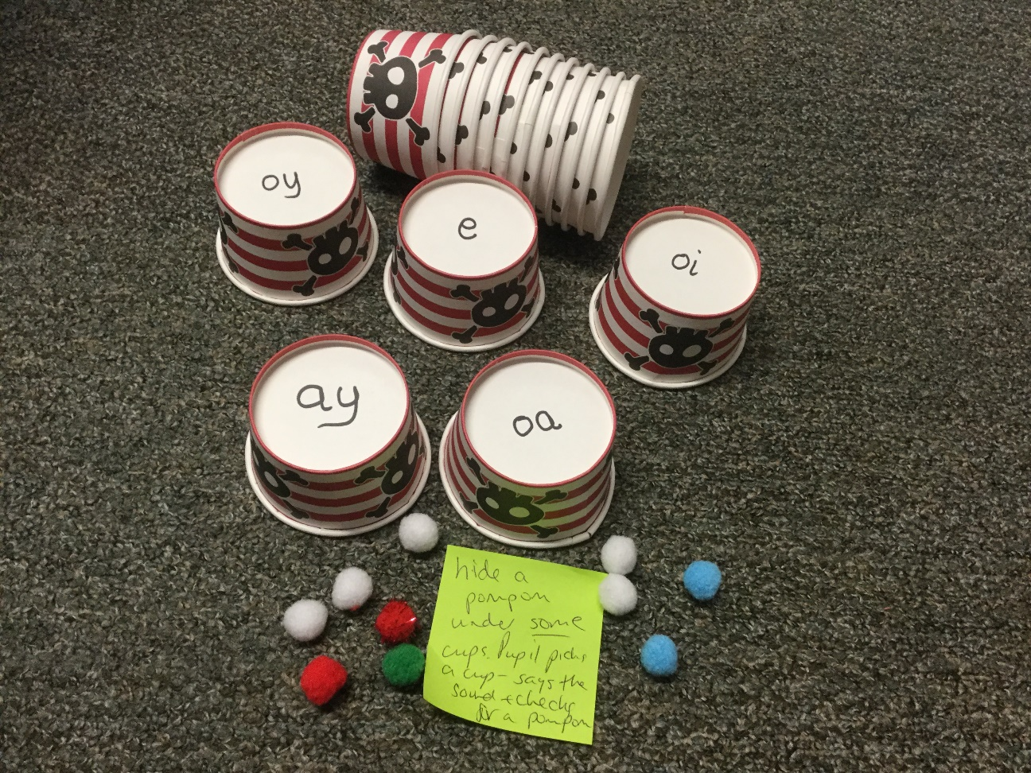
Making it fun
Notes:
JD
Vowel digraphs – aim to collect as many pom poms as possible – have to say sound, think of a word with sound and collect pom pom if get it right

Slide 37
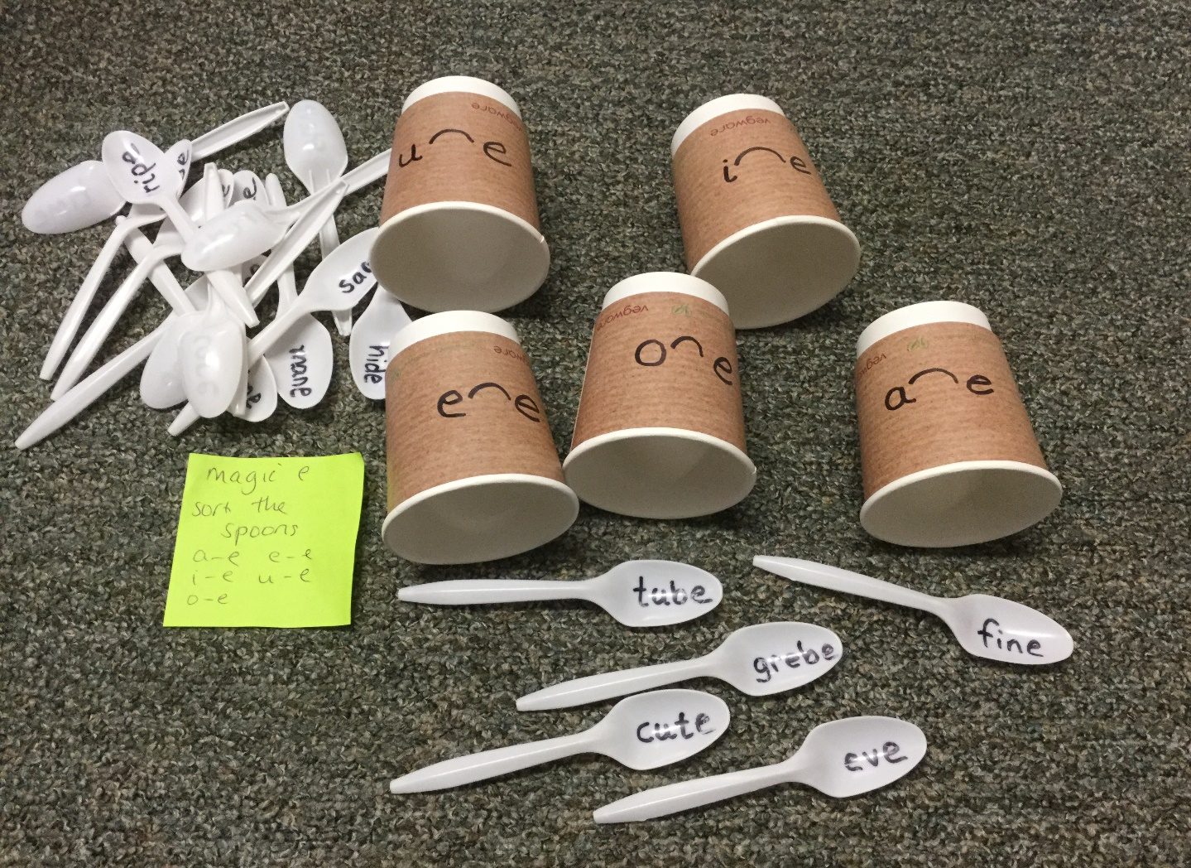
Making it fun

